Slide 1
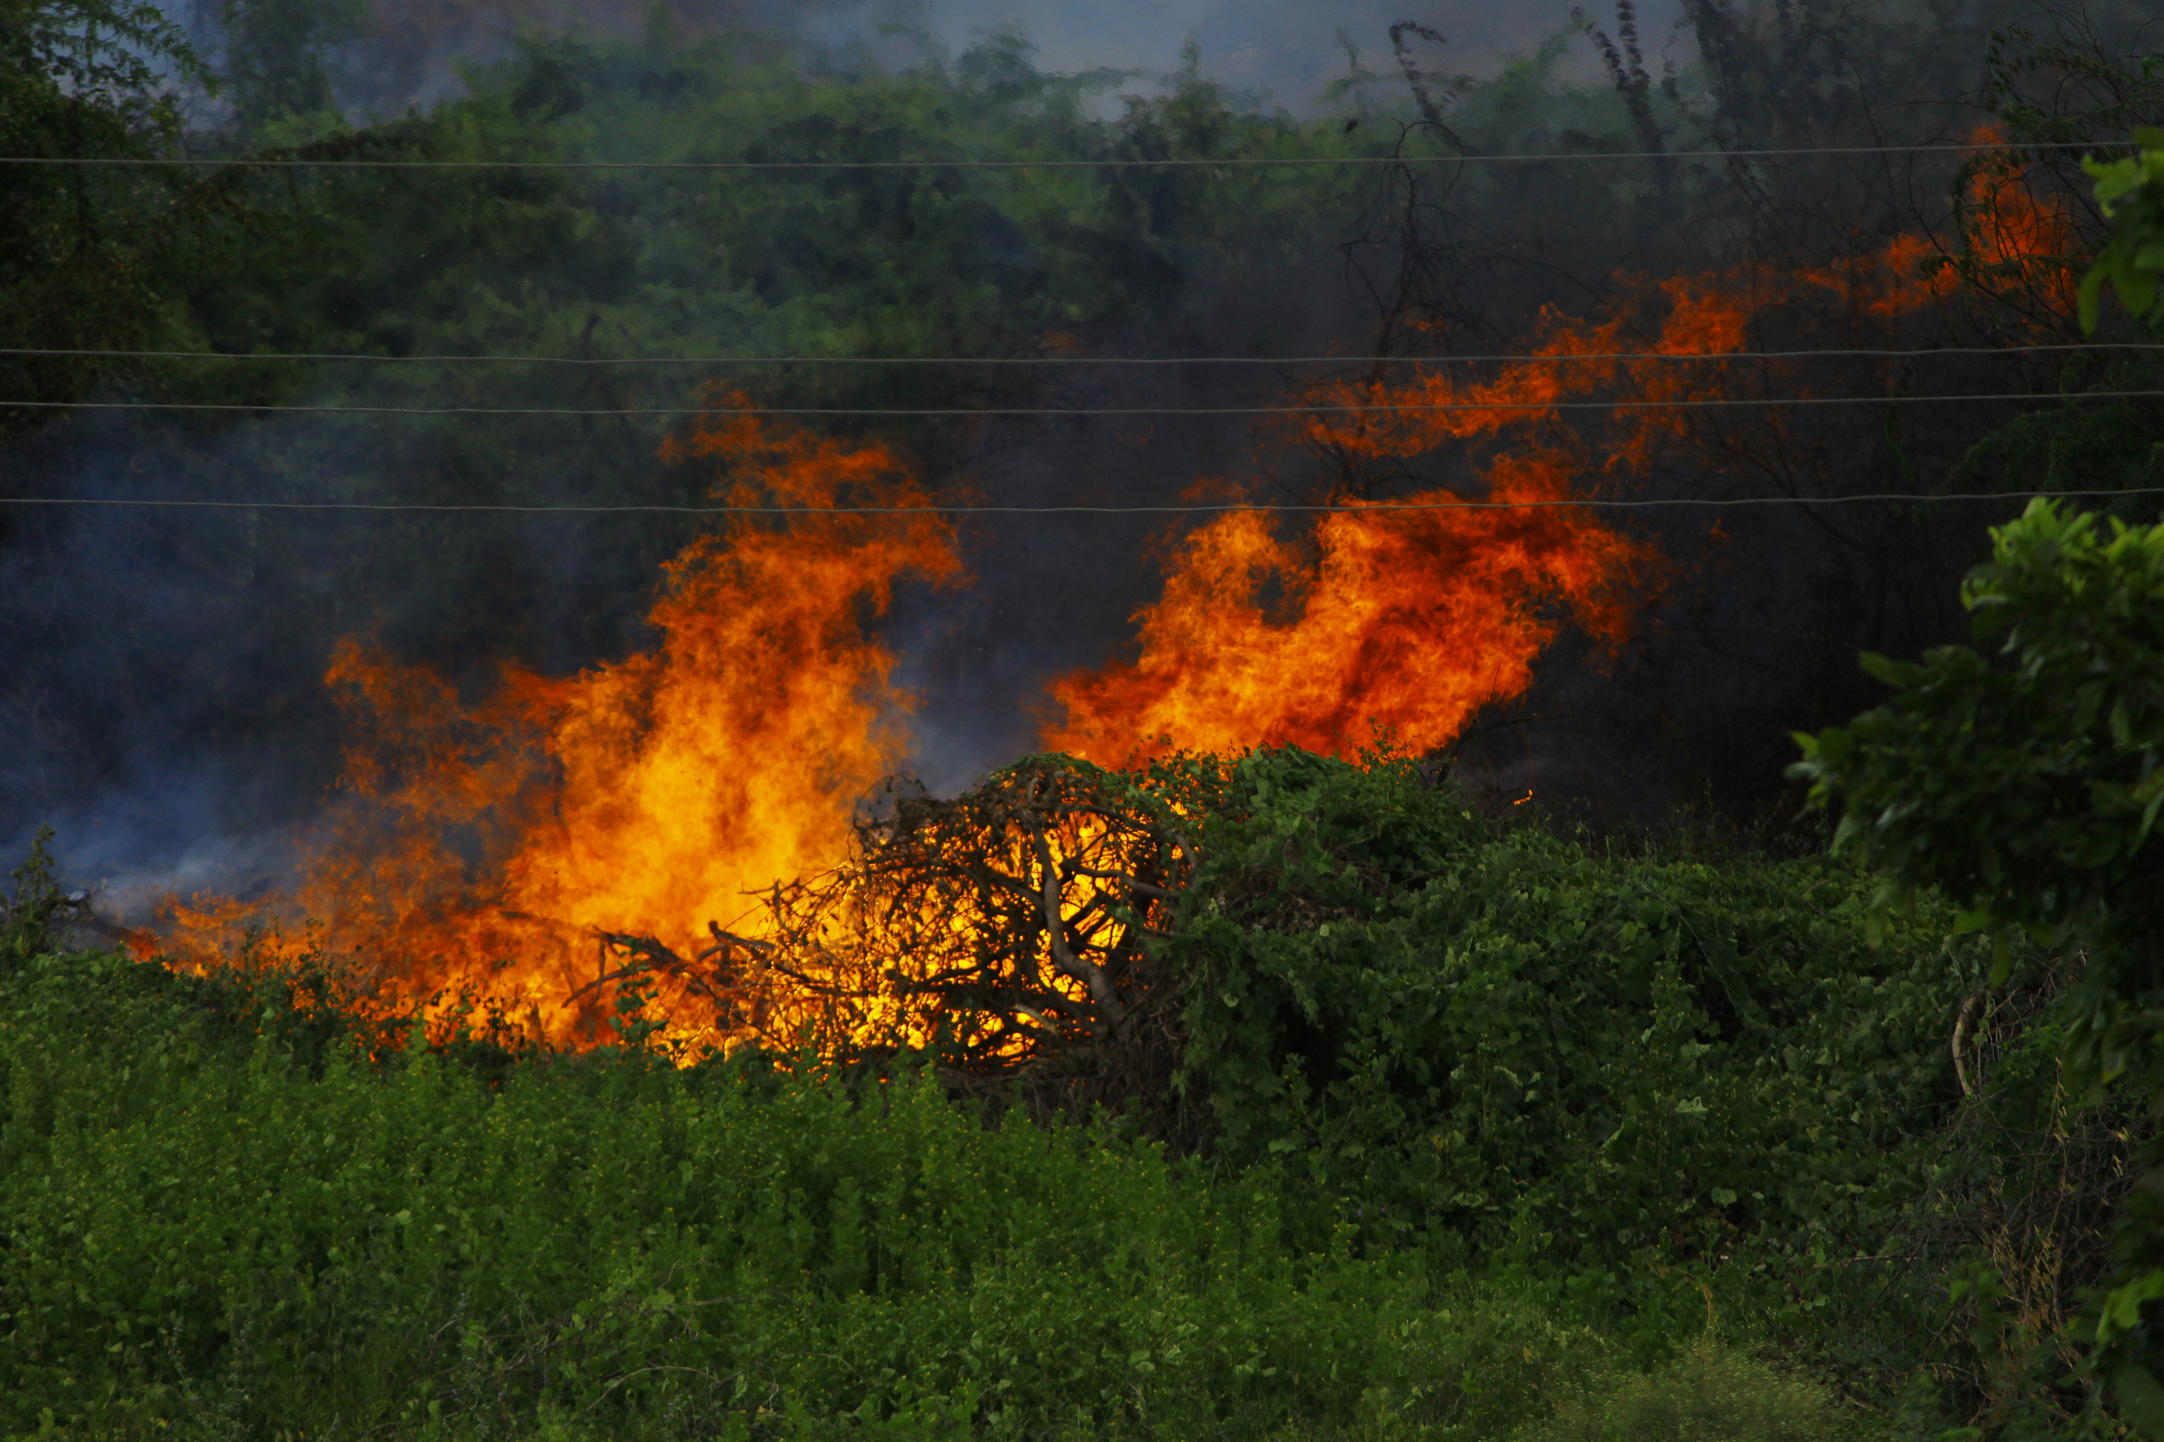

Project presentation
Real-Time forest fire detection using Computer Vision
ILYMA

Slide 2


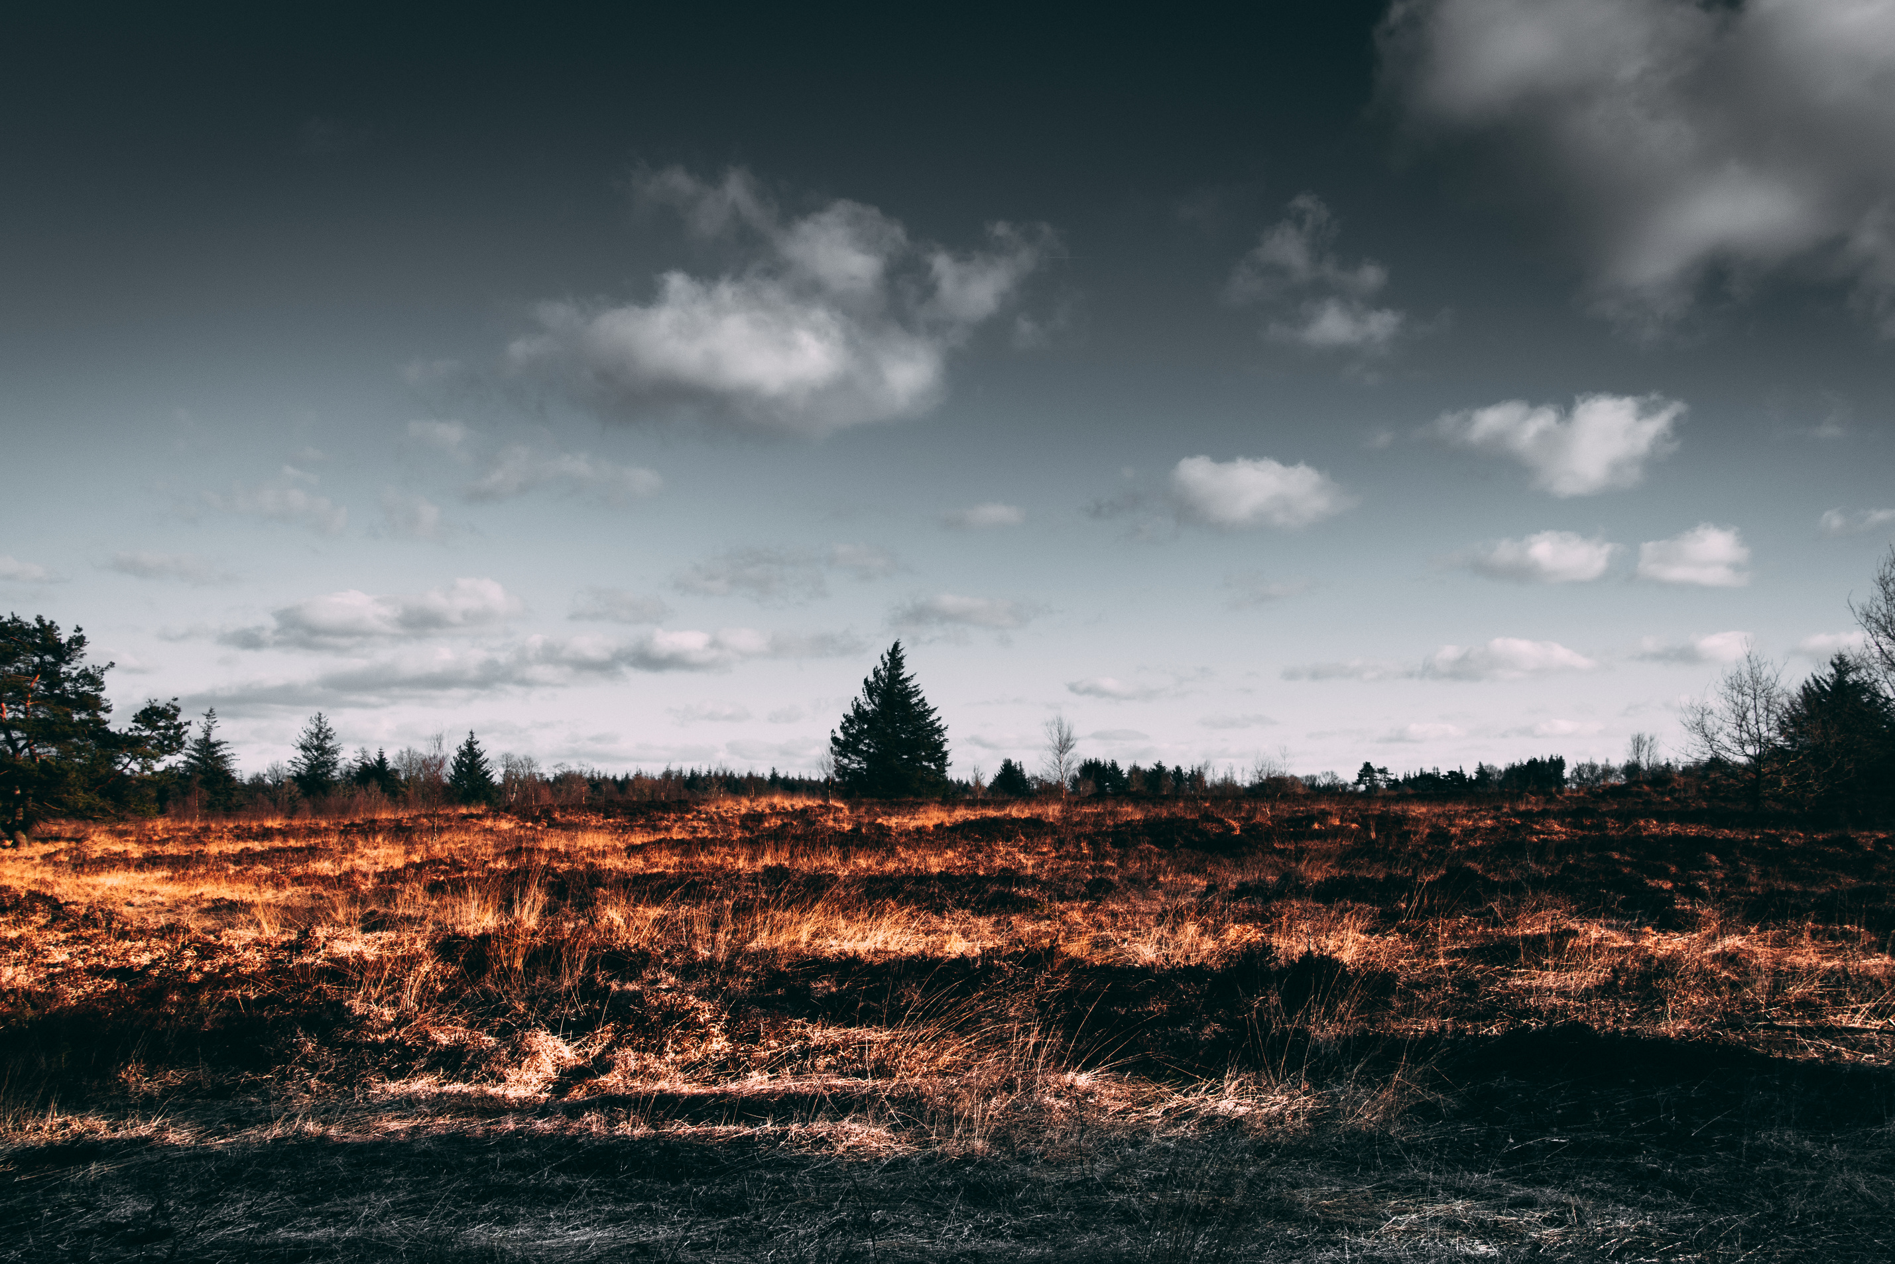
Contents
03/
Implementation
01/
Issues with forest fires
04/
Future Enhancements
02/
Introduction

Slide 3
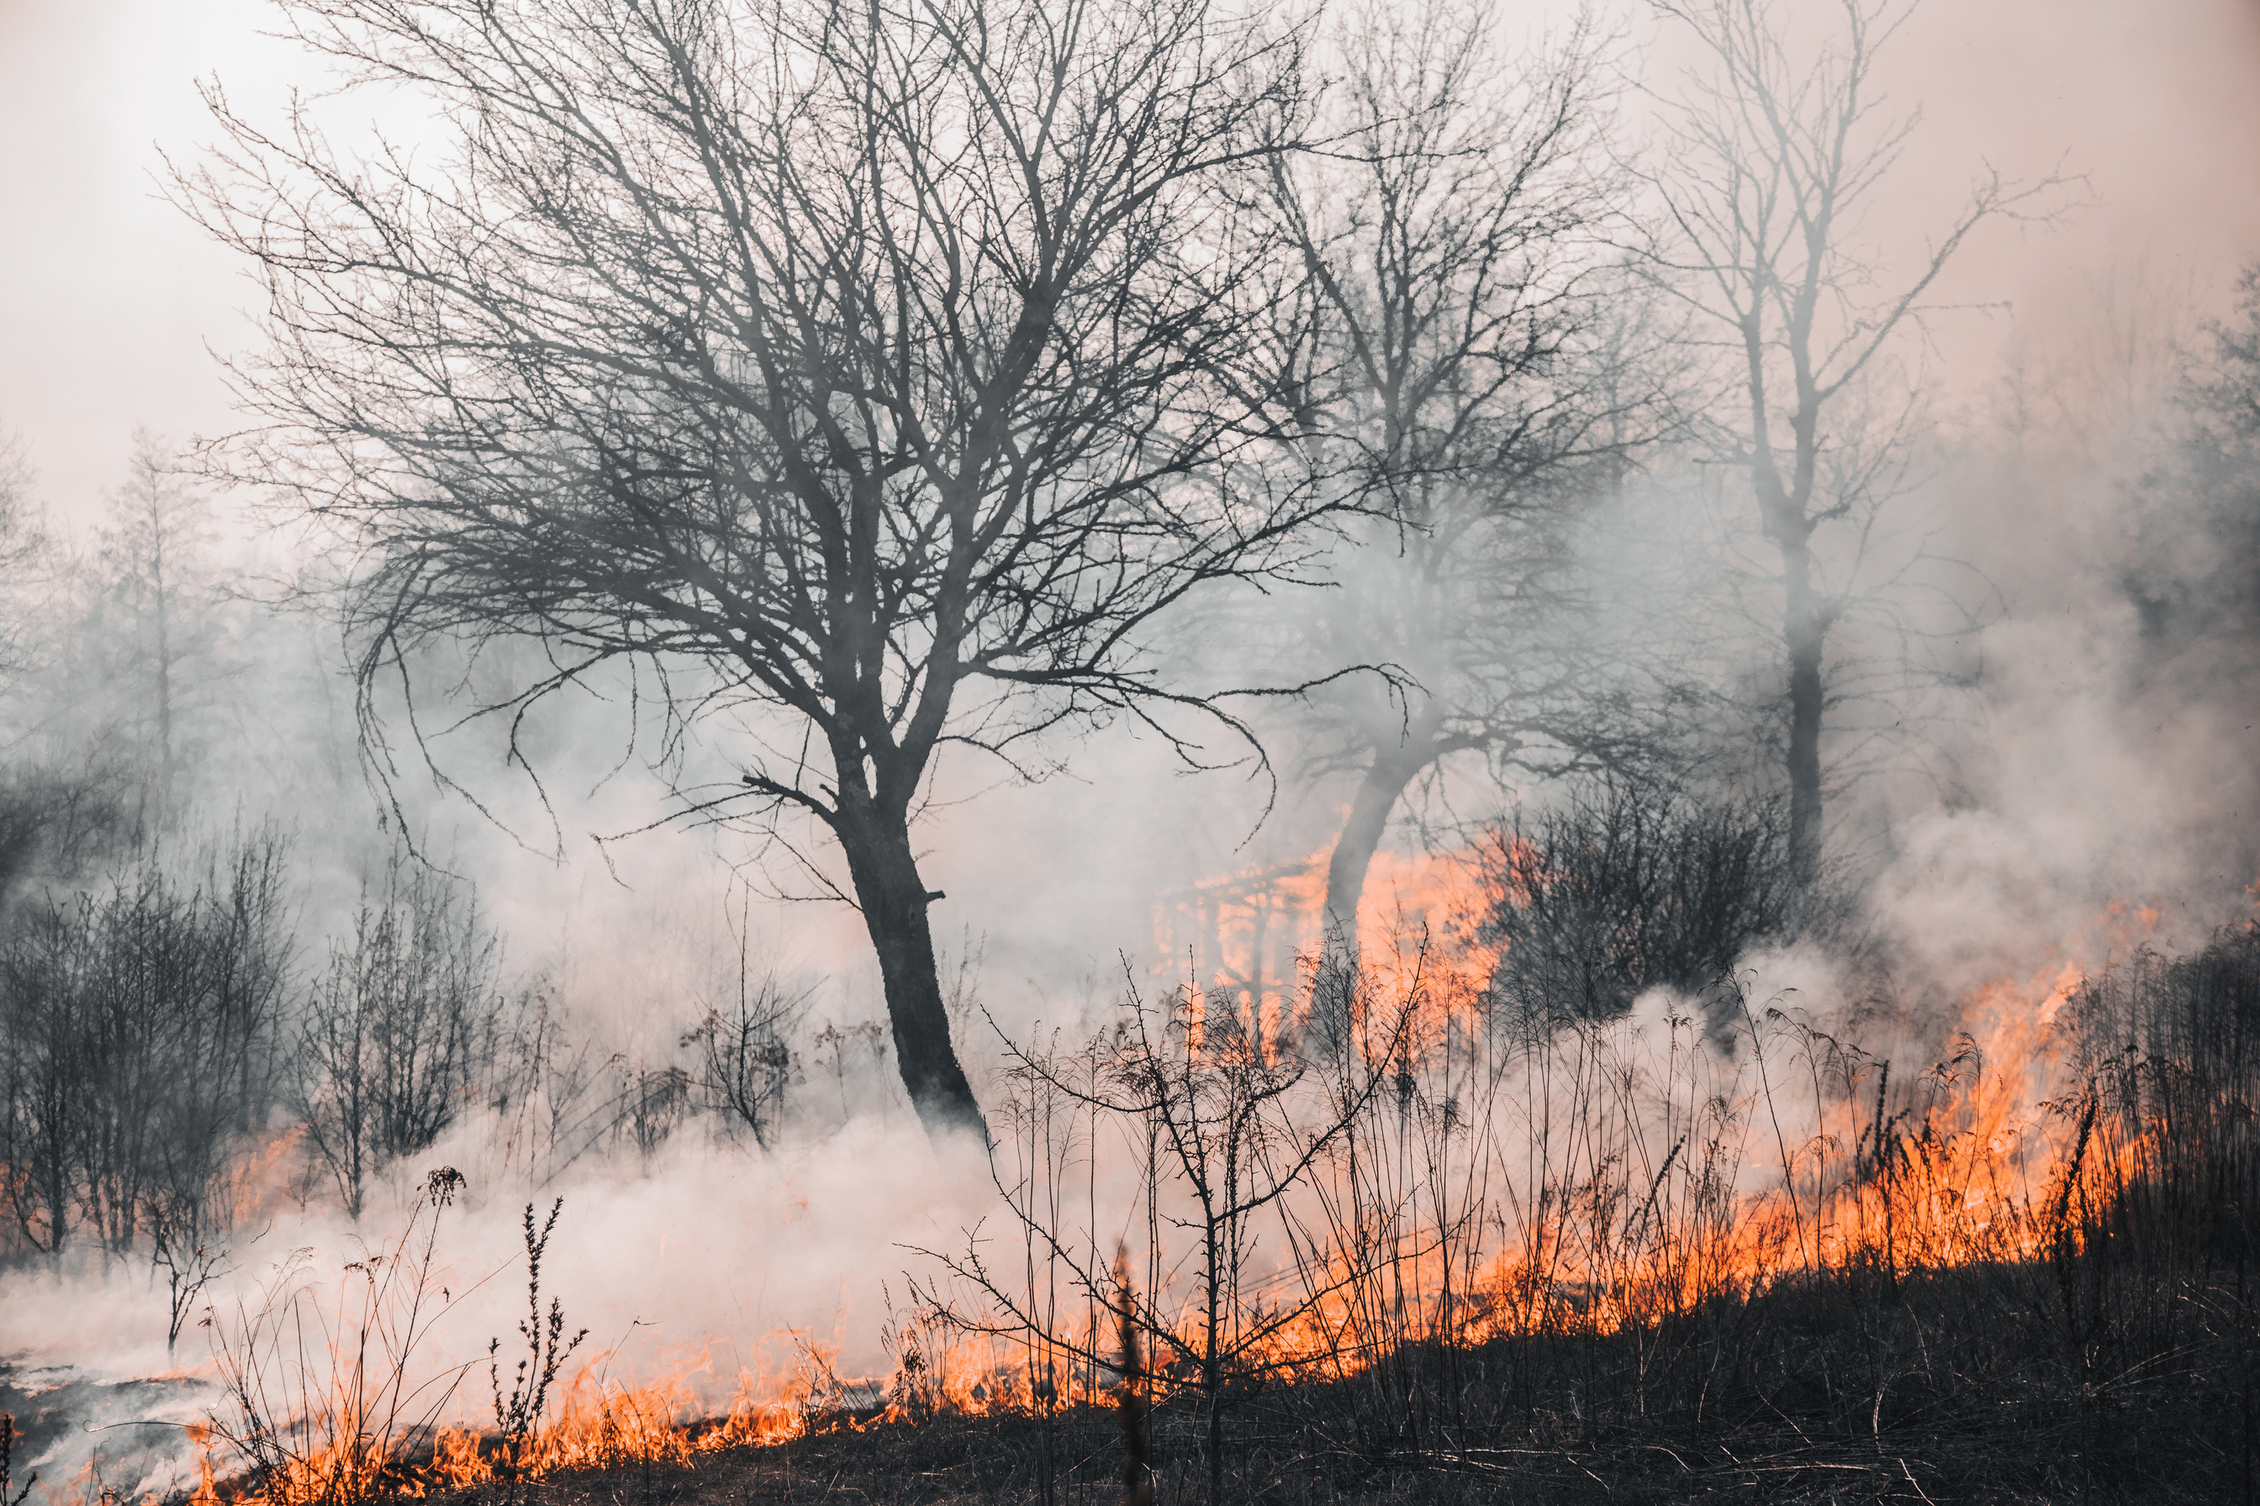
01/ Issues with forest fire
Over the last few decades, forest fire has been a growing issue in both national and international levels. The highest number of incidents typically occur during the months of March and April of each year in our country. Despite 2021 recording a staggering 6,279 forest fires, the situation is expected to worsen in 2023, with projections indicating over 9000 forest fires in our country.

Slide 4
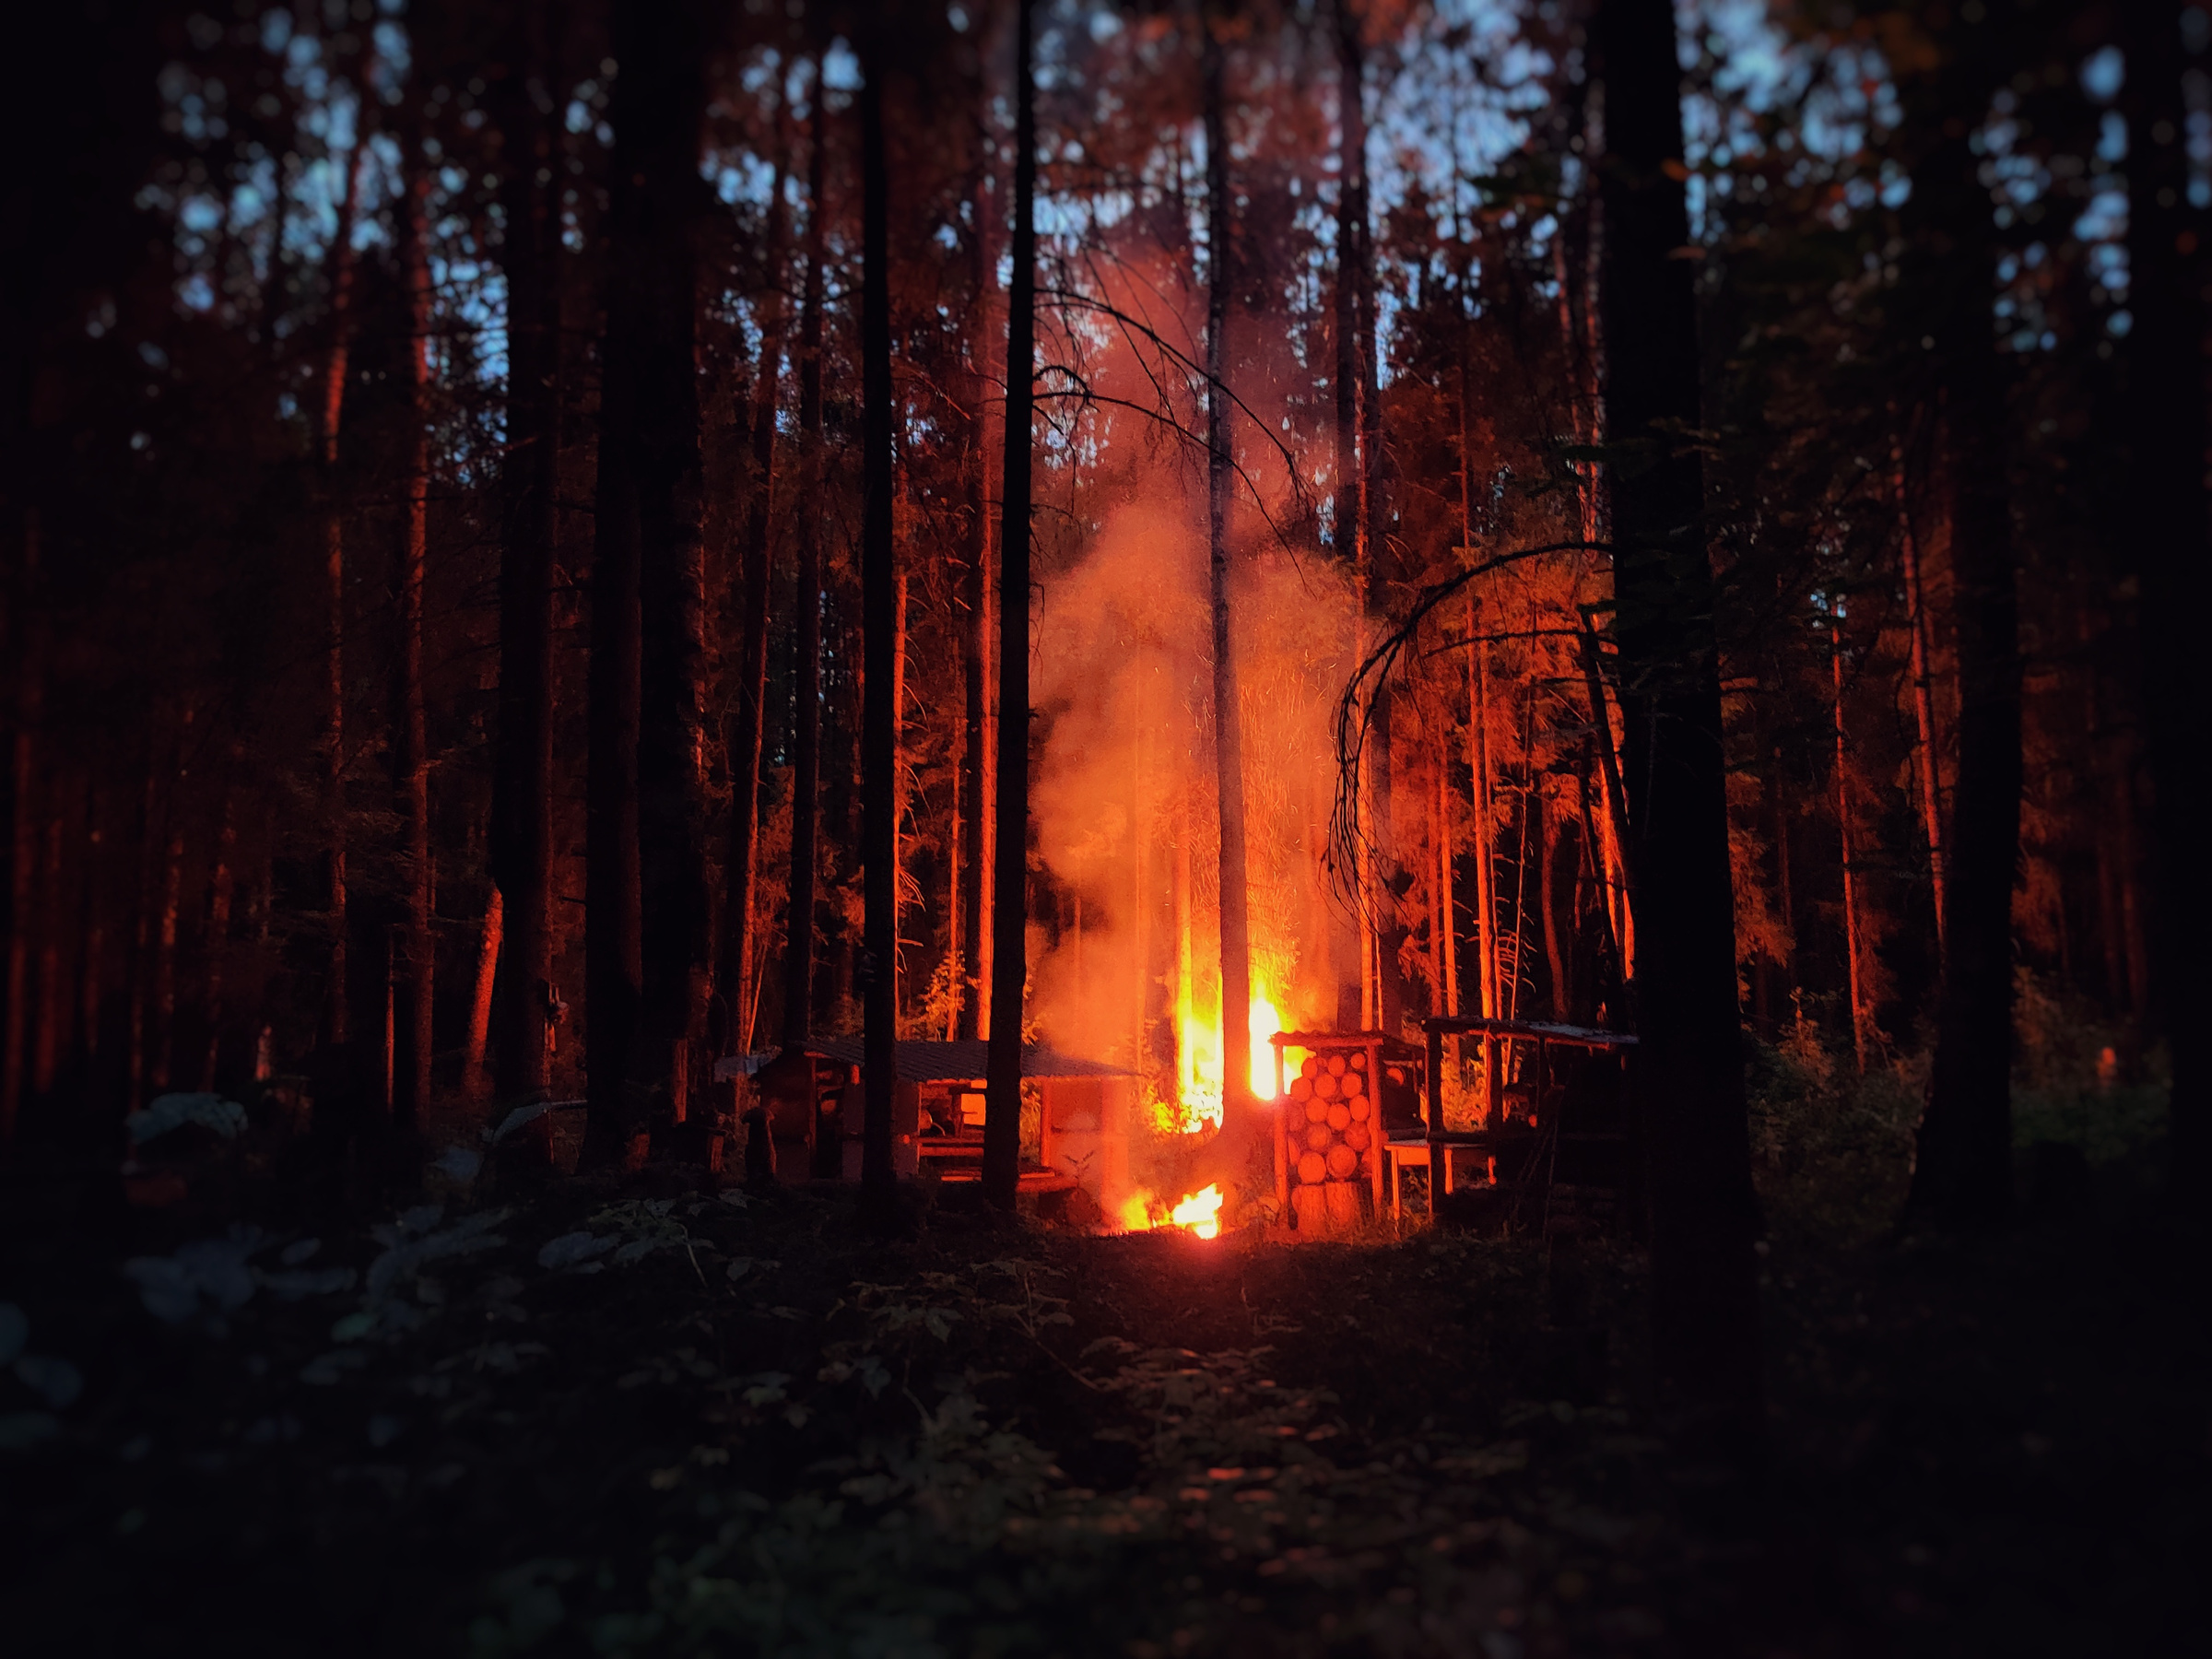
02/ Introduction of Project
Our project encapsulates a portable forest fire detection device powered by cutting edge computer vision technologies that allows us to run it on single board computer with 360 cameras for all round vision.

Slide 5



03/
Implementation
We've harnessed the capabilities of the YOLOv8 nanoarchitecture, fine-tuning it with precision using the forest fire detection Kaggle dataset licensed under Creative Commons 4. This architecture seamlessly operates in real-time video streams, promptly triggering hardware alerts when its prediction confidence exceeds the preset threshold.
Our system excels in real-time fire detection, thanks to ESP32 and A9G hardware modules. They swiftly send emergency SMS alerts to authorities, often forest rangers, providing vital GPS coordinates and impactful images to aid rapid and accurate response, minimizing false alarms and optimizing firefighting efforts.

Slide 6

03.1/
AI Implementation
YOLOv8 is the latest iteration from the YOLO family of models. They provide highly accurate predictions on classes they are pre-trained in and can also learn new classes comparatively easily. It has the ability to predict every object present in an image with one forward pass.
36%

Slide 7
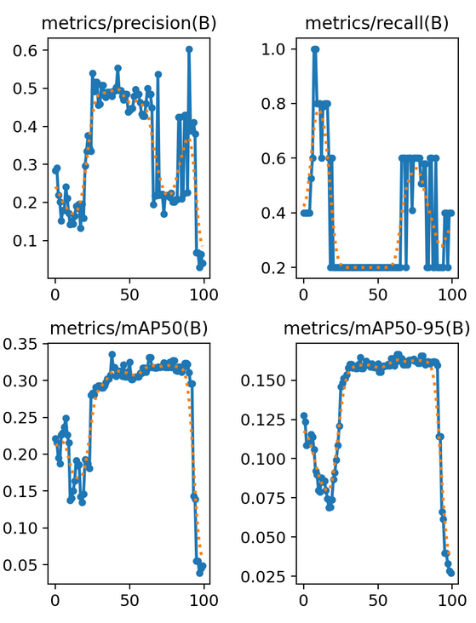
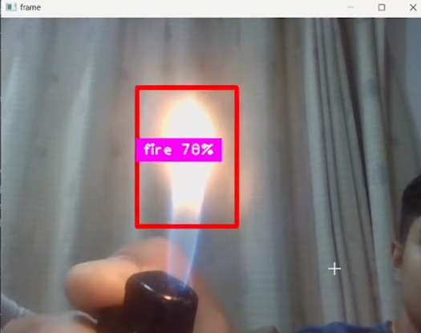
03.1/
AI Implementation

Slide 8
03.2/ Hardware Implementation
Our system excels in real-time fire detection, employing ESP32 and A9G hardware modules for swift emergency SMS notifications to authorities, typically forest rangers, skilled in addressing such situations. These messages contain vital details, including GPS coordinates of the hotspot and suspected images, aiding rangers in discerning false alarms and enhancing their response efficiency against forest fires.

Slide 9
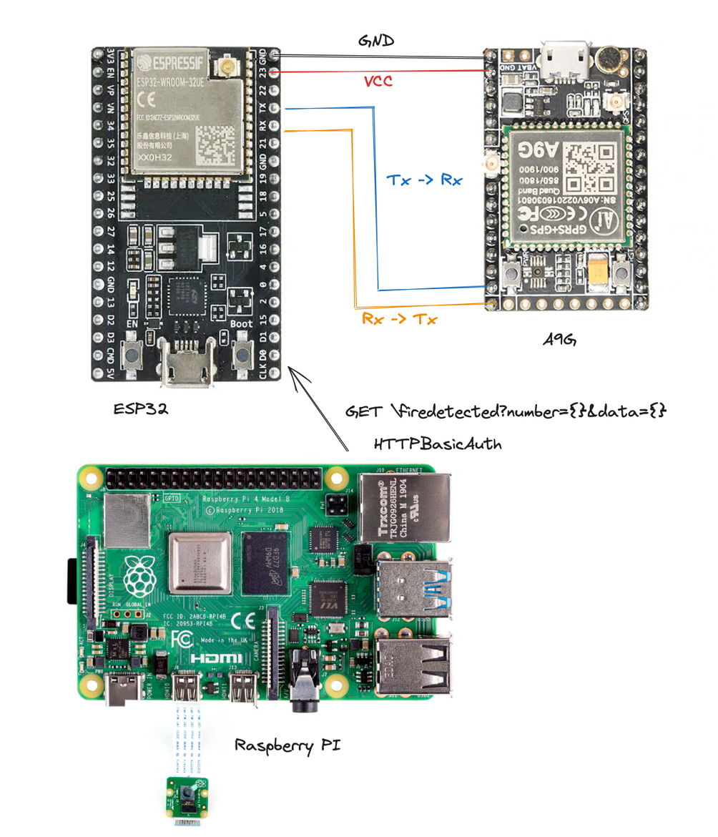
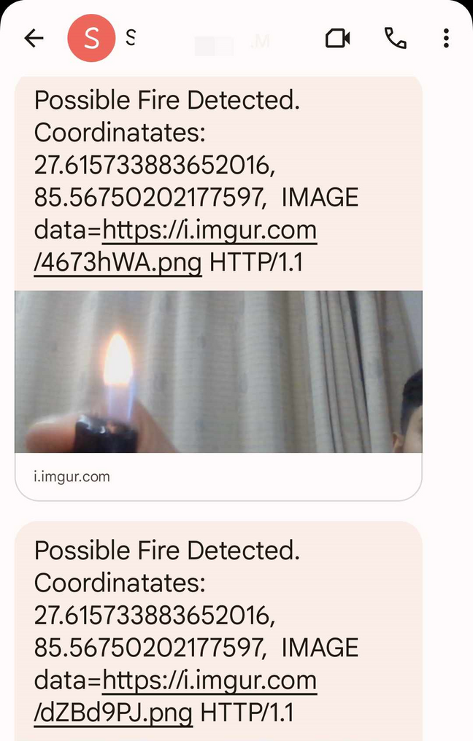
03.2/ Hardware Implementation

Slide 10
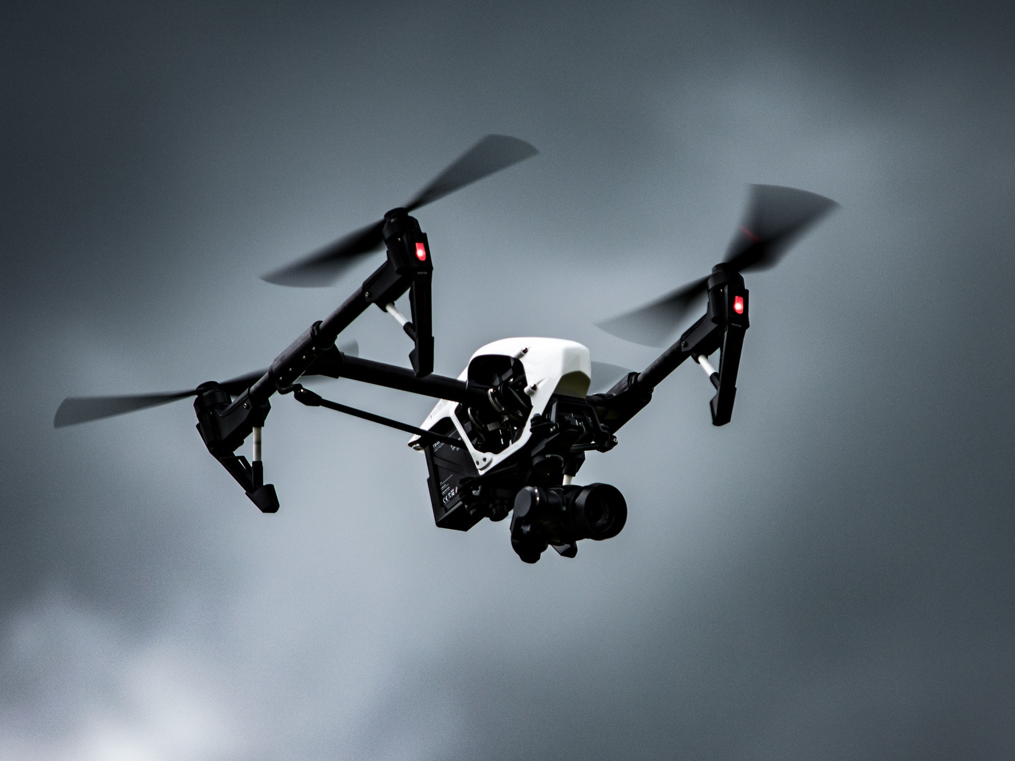
03/
Future Enhancements
Depth perception in captured images for approximate wildfire location.
Drone based forest surveillance.
Dataset enhancement.

Slide 11
Kathmandu University
Thank You

